Slide 1
Lecture 2 - Distributed System Architectures

Slide 2
Definitions
Software Architectures – describe the organization and interaction of software components; focuses on logical organization of software (component interaction, etc.)
System Architectures - describe the placement of software components on physical machines

Slide 3
Architectural Styles
An architectural style describes a particular way to configure a collection of components and connectors.
Component - a module with well-defined interfaces; reusable, replaceable
Connector – communication link between modules
Architectures suitable for distributed systems:
Layered architectures*
Component-based architectures*
Data-centered architectures
Event-based architectures

Slide 4
Layered Architecture
Each layer/tier is allocated a specific responsibility of
the system
Each layer can only interact with the neighboring layers (important for integrity and security)
Each layer may contain layers of its own (e.g. Presentation layer could contain two layers: client layer and client presentation layer)

Slide 5
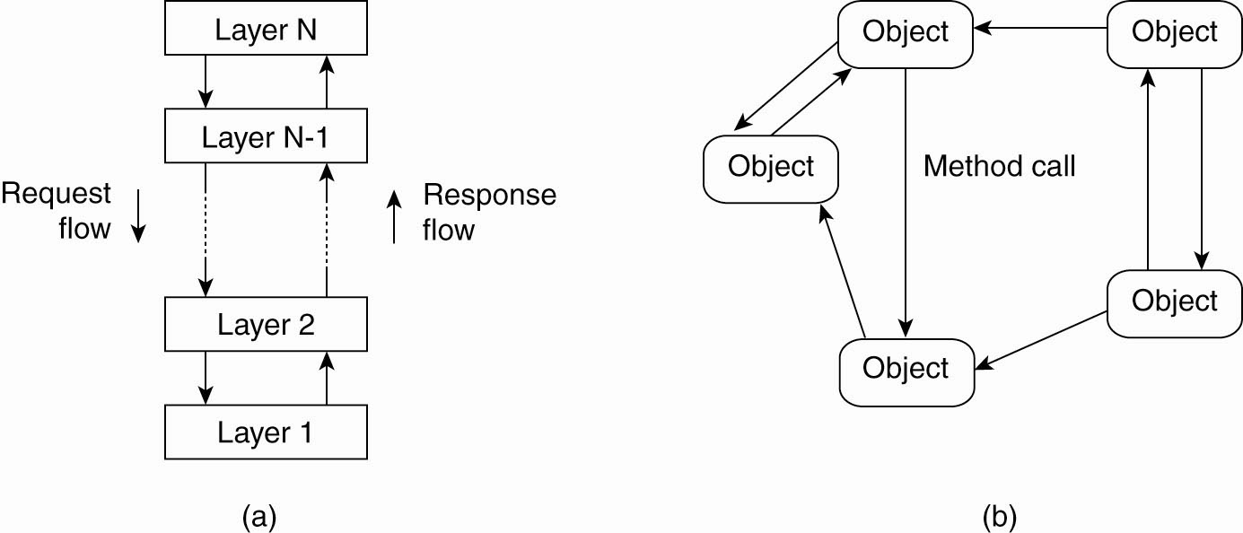
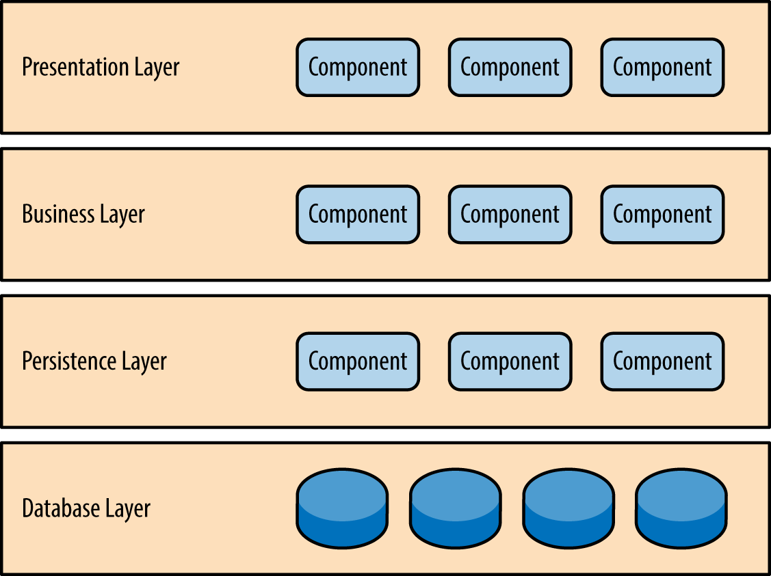
Layered Architecture

Slide 6
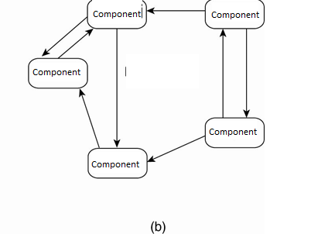
Component based architecture
Consists of components and connectors
Component based is less structured

Slide 7
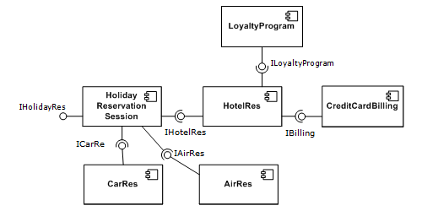
Component based architecture

Slide 8
Data-Centered Architectures
Main purpose: data access and update
Processes interact by reading and modifying data in some shared repository (active or passive)
Traditional data base (passive): responds to requests
Blackboard system (active): clients solve problems collaboratively; system updates clients when information changes.

Slide 9
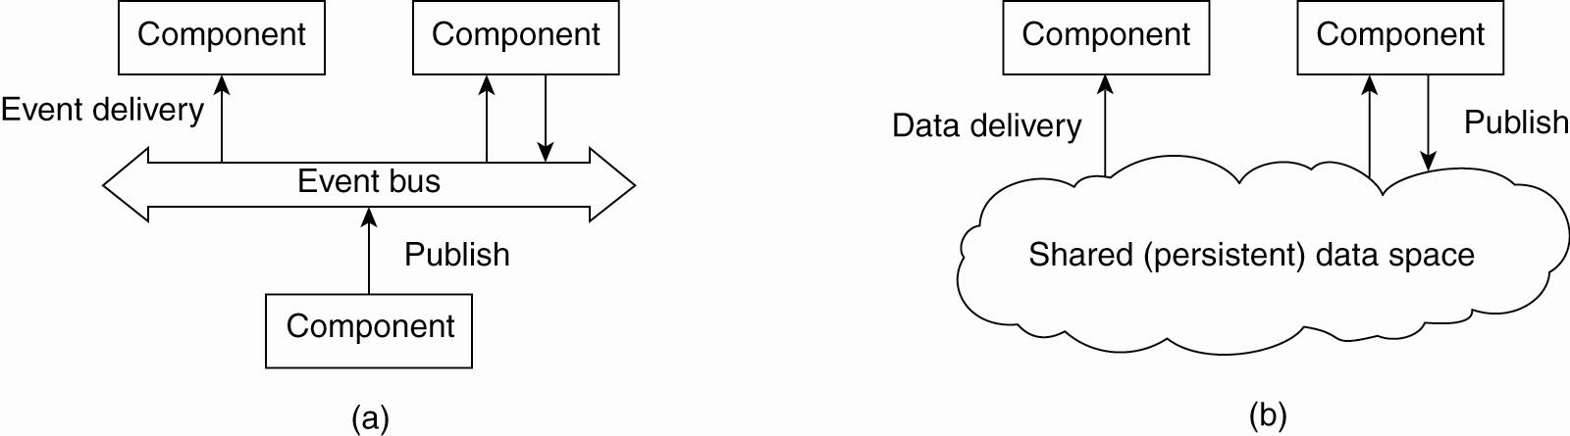
Event based Architectures

Slide 10
Event based Architectures
Communication via event propagation, in dist. systems seen often in Publish/ Subscribe; e.g., register interest in market info; get email updates
Decouples sender & receiver; asynchronous communication
Event-based architecture supports several communication styles:
Publish-subscribe
Broadcast
Point-to-point

Slide 11
Shared Data-Space Architecture
Multiple Architectures can be combined in the same system architecture
E.g. A component in the object based architecture may have a layered architecture
Shared Data-Space Architecture combines the Data-centric architecture and Event based architecture

Slide 12
Shared Data-Space Architecture
E.g., shared distributed file systems or Web-based distributed systems
Processes communicate asynchronously

Slide 13
Which Software Architecture?
An online forum to share travel information among users
A remote monitoring system that monitors the health of an elderly person.
A music file sharing system among a group of users.
A mobile taxi app

Slide 14
Distribution Transparency
An important characteristic of software architectures in distributed systems is that they are designed to support distribution transparency.
Transparency involves trade-offs
Different distributed applications require different solutions/architectures
There is no “silver bullet” – no one-size-fits-all system. (Compare NOW, Seti@home, Condor)

Slide 15
System Architectures

Slide 16
System Architectures for Distributed Systems
Centralized: traditional client-server structure
Vertical (or hierarchical) organization of communication and control paths (as in layered software architectures)
Logical separation of functions into client (requesting process) and server (responder)
Decentralized: peer-to-peer
Horizontal rather than hierarchical comm. and control
Communication paths are less structured; symmetric functionality
Hybrid: combine elements of C/S and P2P
Edge-server systems
Collaborative distributed systems.
Classification of a system as centralized or decentralized refers to communication and control organization, primarily.

Slide 17
Traditional Client-Server
Processes are divided into two groups (clients and servers).
Synchronous communication: request-reply protocol
In LANs, often implemented with a connectionless protocol (unreliable)
In WANs, communication is typically connection-oriented TCP/IP (reliable)
High likelihood of communication failures

Slide 18
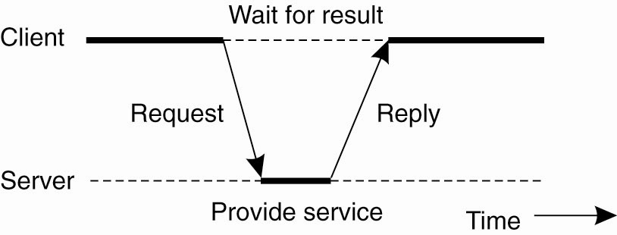
C/S Architectures
Figure 2-3. General interaction between a client and a server.

Slide 19
Two-tiered C/S Architectures
Server provides processing and data management; client provides simple graphical display (thin-client)
Perceived performance loss at client
Easier to manage, more reliable, client machines don’t need to be so large and powerful
At the other extreme, all application processing and some data resides at the client (fat-client approach)
Pro: reduces work load at server; more scalable
Con: harder to manage by system admin, less secure

Slide 20
Three-tiered Architectures
In some applications servers may also need to be clients, leading to a three level architecture
Distributed transaction processing
Web servers that interact with database servers
Distribute functionality across three levels of machines instead of two.

Slide 21
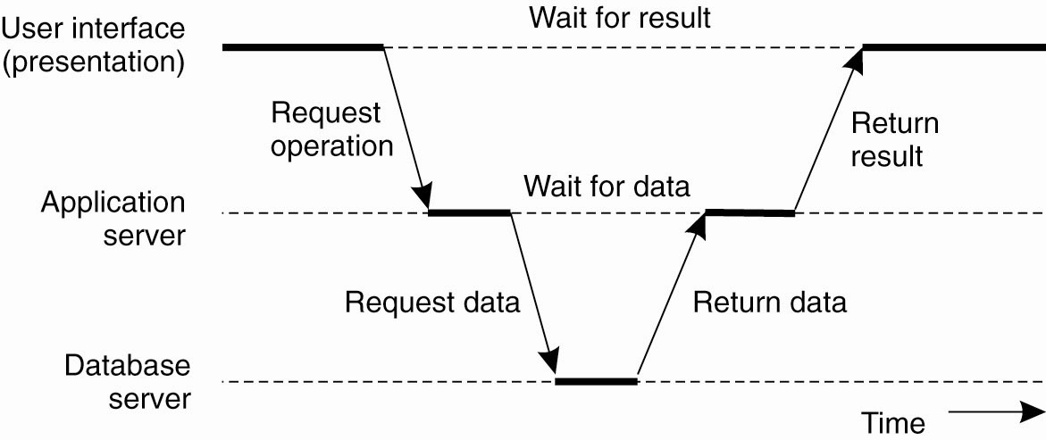
Multitiered Architectures (3 Tier Architecture)
Figure 2-6. An example of a server acting as client.

Slide 22
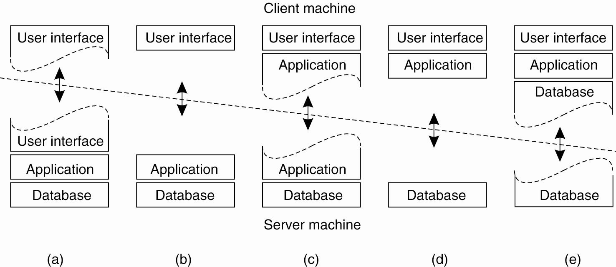
Multitiered Architectures
Thin Client
Fat Client
Figure 2-5. Alternative client-server organizations (a)–(e).

Slide 23
Layered (software) Architecture for Client-Server Systems
User-interface level: GUI’s (usually) for interacting with end users
Processing level: data processing applications – the core functionality
Data level: interacts with data base or file system
Data usually is persistent; exists even if no client is accessing it
File or database system

Slide 24
Examples
Web search engine
Interface: type in a keyword string
Processing level: processes to generate DB queries, rank replies, format response
Data level: database of web pages
Stock broker’s decision support system
Interface: likely more complex than simple search
Processing: programs to analyze data; rely on statistics, AI perhaps, may require large simulations
Data level: DB of financial information
Cloud based “office suites”
Interface: access to various documents, data,
Processing: word processing, database queries, spreadsheets,…
Data : file systems and/or databases

Slide 25
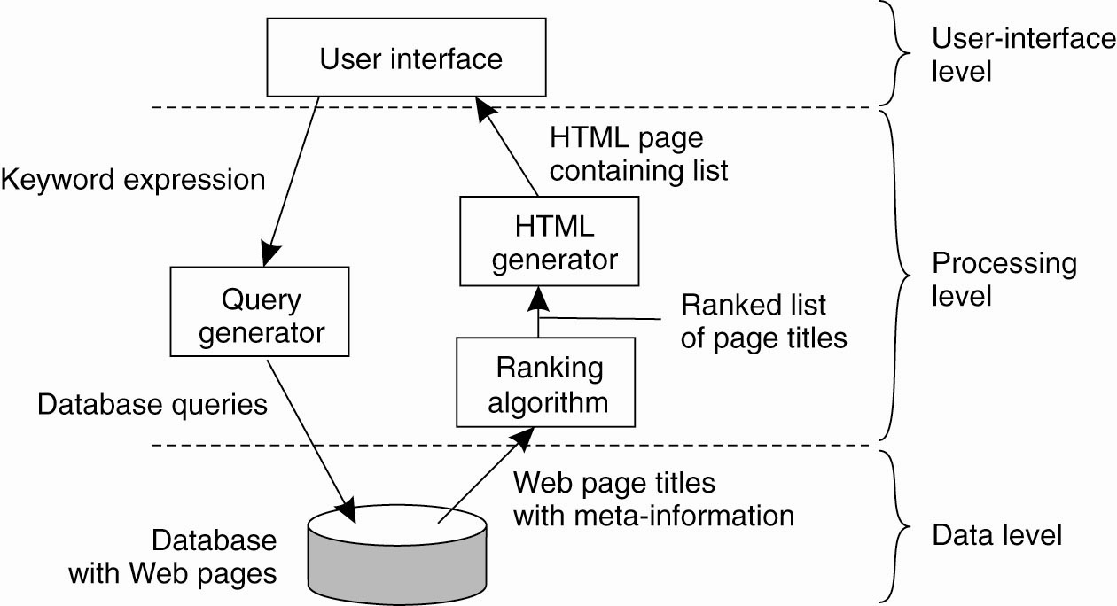
Application Layering
Figure 2-4. The simplified organization of an Internet search engine into three different layers.

Slide 26
Flexible/Scalable Architecture
Display Tier
Presentation Tier
Business Tier
Data Tier
Browser Client
Web Server / ASP.NET
DB 1
Business Logic Server
Data
Server
DB 2
Windows GUI Client
DB 3
WTS GUI Client
Windows/Citrix Terminal Server

Slide 27
Distributing the Business Tier
Business tier could be distributed for various reasons:
Parallel computing - split one job among many servers
Load balancing - have a controller component redirect presentation clients to a least-utilized business tier server
Fault tolerance - robustness to system faults or data faults

Slide 28
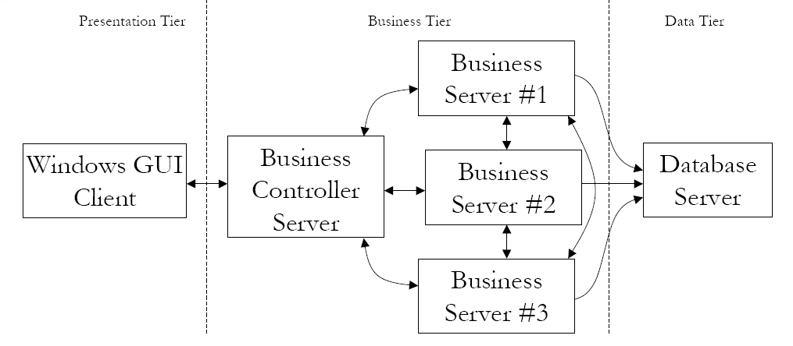
Parallel Computing Architecture
Controller passes job to server farm, returns response
Business servers collaborate via data sharing

Slide 29
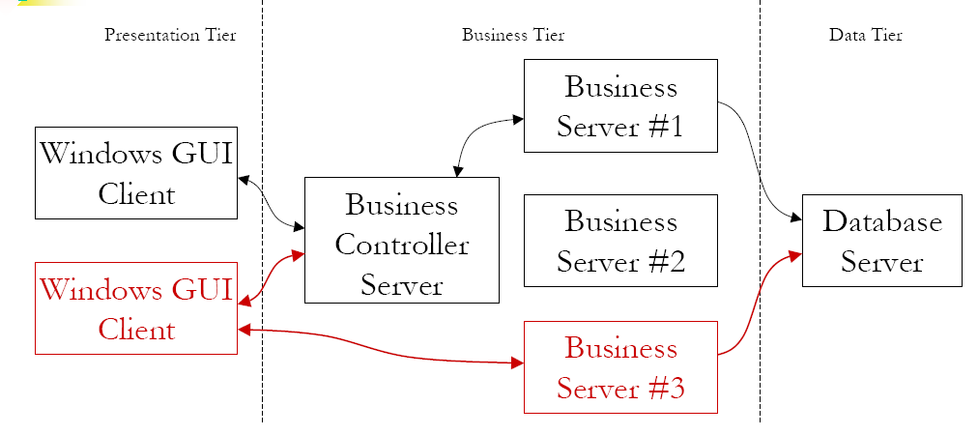
Load Balancing Architecture
Controller passes job to one server, returns response
Alternative: Controller tells client which server to use

Slide 30
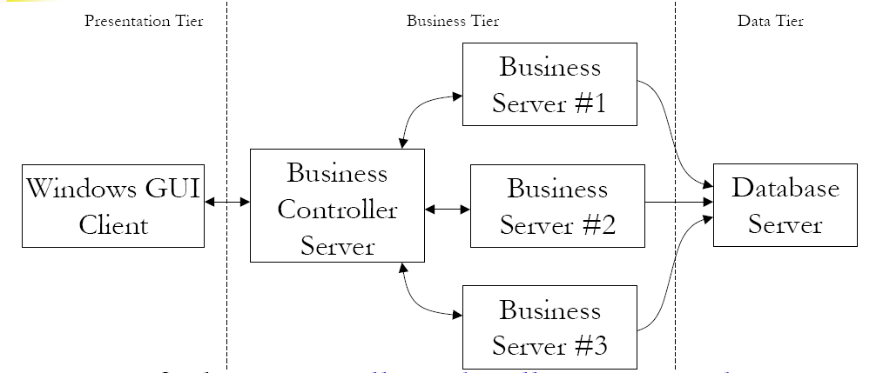
Fault Tolerant Architecture
Data faults: Controller asks all servers to do the same job
Then compares results to detect faults
System faults: Controller uses any server that is up

Slide 31
Whether to tier or not?
Advantages
- Can reuse code (high coherence, low coupling)
- Scalable
- Integrity
- Fault tolerance
Disadvantages
Increases communication overhead
Errors/Losses in message transmission
Can pose security risks (e.g. packet sniffing)
Increased Complexity

Slide 32
Peer-to-Peer
Nodes act as both client and server; interaction is symmetric (e.g. Pastry, Chord)
Each node acts as a server for part of the total system data
Overlay networks connect nodes in the P2P system
Nodes in the overlay use their own addressing system for storing and retrieving data in the system
Nodes can route requests to locations that may not be known by the requester.

Slide 33
P2P v Client/Server
P2P computing allows end users to communicate without a dedicated server.
Communication is still usually synchronous (blocking)
There is less likelihood of performance bottlenecks since communication is more distributed.
Data distribution leads to workload distribution.
Resource discovery is more difficult than in centralized client-server computing & look-up/retrieval is slower
P2P can be more fault tolerant, more resistant to denial of service attacks because network content is distributed.
Individual hosts may be unreliable, but overall, the system should maintain a consistent level of service

Slide 34
P2P
Structured – E.g. Chord
Unstructured – E.g. BitTorrent

Slide 35
Hybrid Architectures
Combine client-server and P2P architectures
Edge-server systems; e.g. ISPs, which act as servers to their clients, but cooperate with other edge servers to host shared content
Collaborative distributed systems; e.g., BitTorrent, which supports parallel downloading and uploading of chunks of a file. First, interact with C/S system, then operate in decentralized manner.
https://www.youtube.com/watch?v=6PWUCFmOQwQ

Slide 36
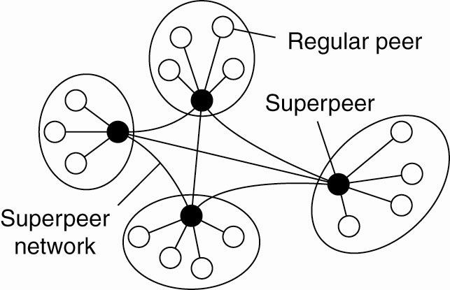
Superpeers
Maintain indexes to some or all nodes in the system
Supports resource discovery
Act as servers to regular peer nodes, peers to other superpeers
Improve scalability by controlling floods
Can also monitor state of network
Example: Napster
Figure 2-12.

Slide 37
Distributed Hash Tables
A fully decentralized routing mechanism
https://www.youtube.com/watch?v=-UU_ugiPZ9k

Slide 38
Possibilities with P2P?
Currently mostly used for file sharing
Blockchain uses P2P
Online Social networks?
Taxi applications?
Etc etc

Slide 39
Centralized v Decentralized Architectures
Traditional client-server architectures exhibit vertical distribution. Each tier serves a different purpose in the system.
Logically different components reside on different nodes
Horizontal distribution (P2P): each node has roughly the same processing capabilities and stores/manages part of the total system data.
Better load balancing, more resistant to denial-of-service attacks, harder to manage than C/S
Communication & control is not hierarchical; all about equal

Slide 40
Architecture versus Middleware
Where does middleware fit into an architecture?
Middleware: the software layer between user applications and distributed platforms.
Purpose: to provide distribution transparency
Applications can access programs running on remote nodes without understanding the remote environment

Slide 41
Architecture versus Middleware
Middleware may also have an architecture
e.g., CORBA has an object based style.
Use of a specific architectural style can make it easier to develop applications, but it may also lead to a less flexible system.
Possible solution: develop middleware that can be customized as needed for different applications with different architectures.

Slide 42
Summary
Software Architecture Vs System Architecture
Different Software Architectural styles – Layered, Component based, event driven, data centered…
Can have combinations of these styles
Different System Architectures – Client Server, Peer to Peer, Hybrid

